Slide 1

Systems
System Response
Presented by [Your Name], [Your Affiliation]

Slide 2
Introduction
Importance of the Particular Integral
The Big Picture: In linear systems, the total response is the sum of the Natural Response (C.F.) and the Forced Response (P.I.).
Linear Non‑homogeneous ODE:
aₙ dⁿy/dxⁿ + … + a₁ dy/dx + a₀ y = X
Where $X = x^n$ (a polynomial input like a constant, ramp, or parabolic signal).
What is P.I.? It is the specific solution that satisfies the equation when the right-hand side is non-zero.

Slide 3
Operator Form
Understanding Inverse Operators
If D represents differentiation, D y = dy/dx, then 1/D represents its inverse: integration, while
yₚ = (1 / f(D)) xⁿ
Differential Operator
Equation Representation
Inverse Operator Concept
The operator D = d/dx changes a function so it can be solved more easily. Using D², D³, and higher powers keeps applying this change to move toward the solution.
By expressing the differential equation in the form (f(D) y = x^n), we can utilize the operator notation to systematically derive the particular integral and analyze system responses effectively.
The particular integral can be written as yₚ = (1 / f(D)) xⁿ, allowing us to apply inverse operators, which simplify the calculation process by addressing polynomial input transformations.

Slide 4
The Binomial Expansion
Key Tools for Inverse Operators
Binomial Expansion 1
Binomial Expansion 2
Using the series (1 + D)⁻¹ = 1 − D + D² − D³ + … allows us to invert the operator efficiently, enabling us to handle polynomial inputs through series terms.
Similarly, (1 − D)⁻¹ = 1 + D + D² + D³ + … helps us work out inverse operators and find the needed expressions for different polynomial degrees.

Slide 5
Step-by-Step Algorithm
Practical Procedure for Finding P.I.
Factor Lowest Term
Standardize: Write the equation in operator form as f(D) y = xⁿ.
Isolate 1 / f(D): Express yₚ = (1 / f(D)) xⁿ.
Factor Out: Take the lowest power of D outside so the first term becomes 1.
Expand: Apply the binomial series.
Operate: Multiply xⁿ into the bracket and differentiate each term.
Simplify: Collect all terms for the final result.
To normalize the first term to 1, factor out the lowest power of (D) from the operator, ensuring that the expression is simplified for effective calculations.

Slide 6
Worked Example
Calculation of Particular Integral
Final P.I.: ( y_p )
In this example, we apply the operator method to find the Particular Integral for the equation ((D^2 + 2D + 1) y = x^2), resulting in (y_p = x^2 - 4x + 6).

Slide 7
Special Case
What if the lowest degree term is not a constant?
If f(D) = D^2 + 3D, the lowest term is 3D.
Identify the Lowest Power:
Take out the smallest power of D.
For (D² + 4D)y = xⁿ, factor out 4D.
Procedure:
Expand → Integrate
Expand (1 + φ(D))⁻¹ as a series.
Apply each term to xⁿ series to get a new polynomial.
Then apply 1/Dᵏ:
1/D = ∫ dx
1/D² = ∫∫ dx²
1/Dᵏ = k repeated integrals.
Modified Operator Form
Write as:
yₚ = (1 / Dᵏ(1 + φ(D))) · xⁿ
Here, k is the smallest power of D in the given expression.

Slide 8
Applications in Engineering
This method isn't just math—it’s how engineers predict system behavior.
Steady-State Error Analysis: In Control Systems, polynomial inputs represent Step (x^0), Ramp ($x^1$), or Parabolic ($x^2$) signals. The P.I. tells us exactly how much the system will lag behind the command.
Structural Mechanics: Used to find the deflection of beams under distributed loads (where the load is represented by a polynomial function of the distance).
Electrical Circuits: Analyzing the response of RLC circuits when the voltage source is increasing linearly (ramp) or quadratically over time.
Kinematics: Predicting the position of a particle when the acceleration is a function of time (a = t^n).

Slide 9
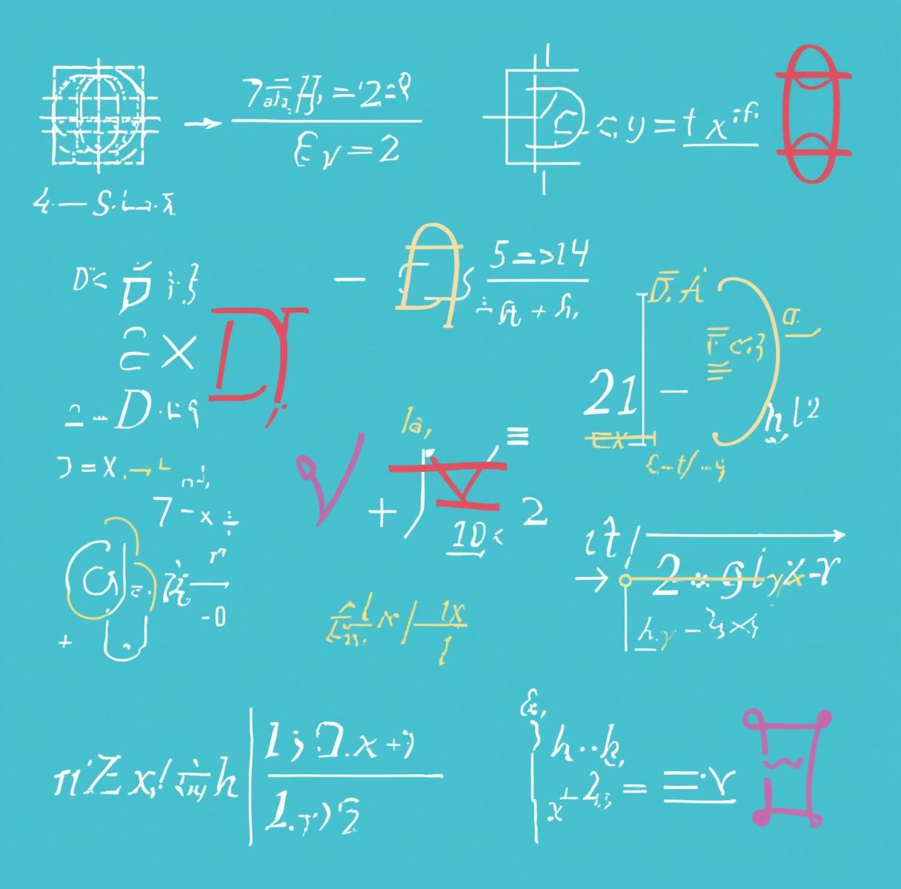
Conclusion
Efficiency: The Binomial method is faster for polynomials than the Method of Undetermined Coefficients.
Accuracy: It provides a systematic "plug-and-play" formula.
Engineering Context: This method is vital for finding the steady-state error in control systems when subjected to ramp or step inputs.

